Slide 1
Module 4: Cloud Computing Service Models

Slide 2
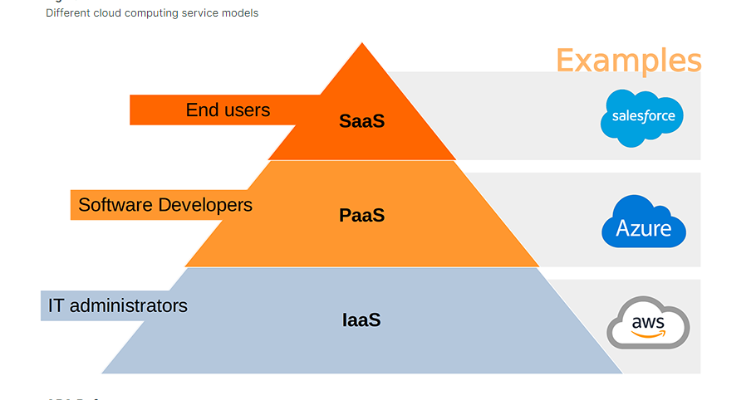

Slide 3
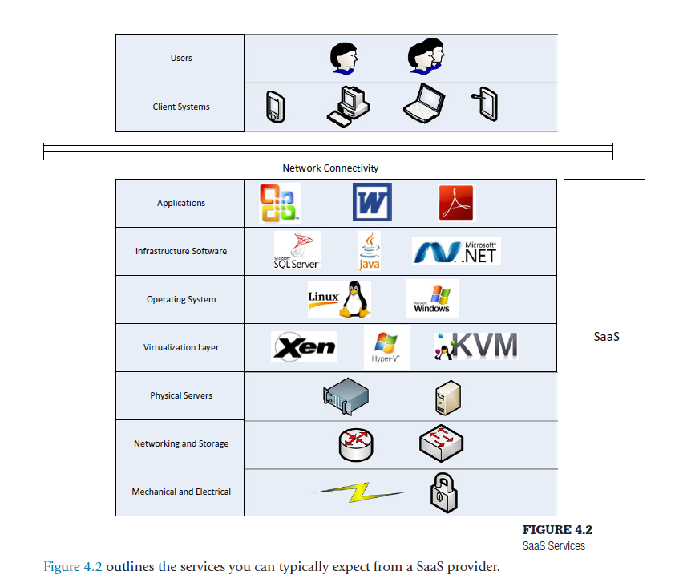
Saas
Notes:
Saas
Paas
Iaas

Slide 4
SaaS Characteristics
Customization: Allowing customization can be very costly for the service provider and, hence, the customer. Having extensive customization can also cause a problem when it comes time do a software upgrade. This may require a large amount of time; and time is money.
Support and Maintenance: Software upgrades are centralized and performed by the service provider. Centralized upgrades can present a problem. When the provider decides it’s time to upgrade, you have little to no choice in the matter. if there is downtime associated with the upgrade, you will simply have to accept it.
Analytics: In SaaS implementations, the provider has the ability to view user activities and determine trends. Understanding trends helps you understand when you may have a spike in usage and therefore a spike in costs.

Slide 5
SaaS Characteristics
Integration: The data will be stored at the provider site. In most cases, the customer will not have direct access to the data. It’s also a problem if you need to do a manual fix of the data or load or reload data in bulk.
Responsibilities: Most of the responsibilities fall on the service provider.
SaaS Drivers: Most SaaS providers offer their services in the form of Web-based applications. So, as acceptance of Web-based applications grows, so does the acceptance of SaaS services.

Slide 6
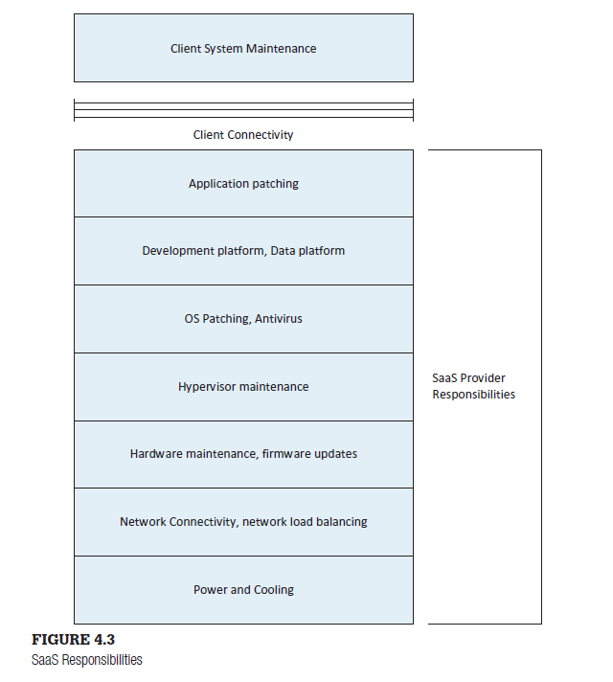
SaaS Responsibilities:

Slide 7
SaaS Challenges
Disparate Location: SaaS applications are generally hosted offsite. This means connections between the client and the application must travel over the public Internet, sometimes long distances. Some applications will not work in environments where there is a great deal of latency.
Multitenancy: Since the application is shared, generally little to no customization can be performed.
Other Security Challenges: Since customers will generally be accessing the same instance of an application, an application flaw may allow one customer access to another customer’s data. The employees at the service provider will have direct access to the systems that house the data…………………….. encrypt the data is the solution.

Slide 8
SaaS Providers
Outlook.com
Google Drive
Salesforce.com

Slide 9
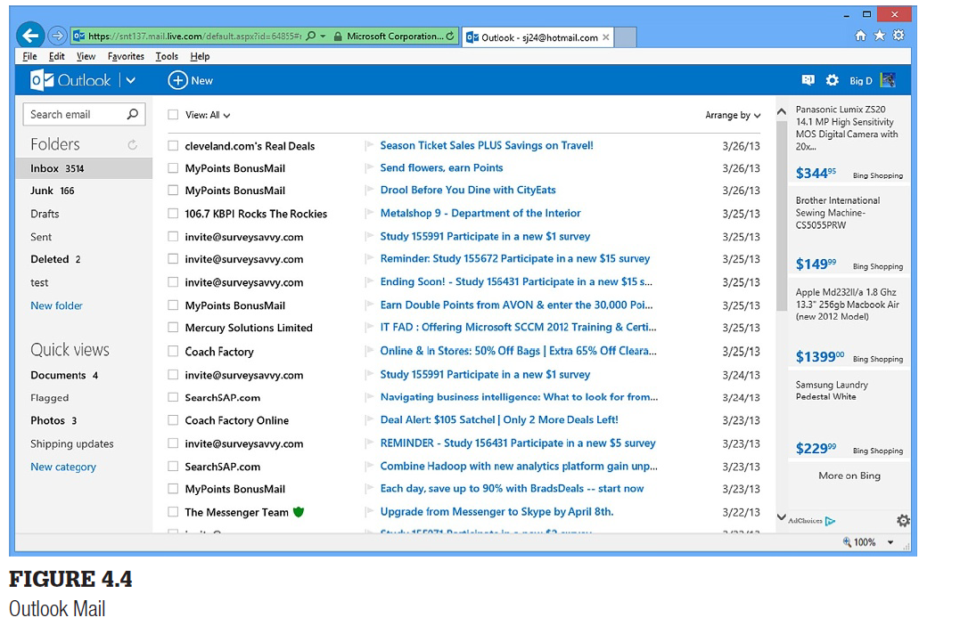

Slide 10
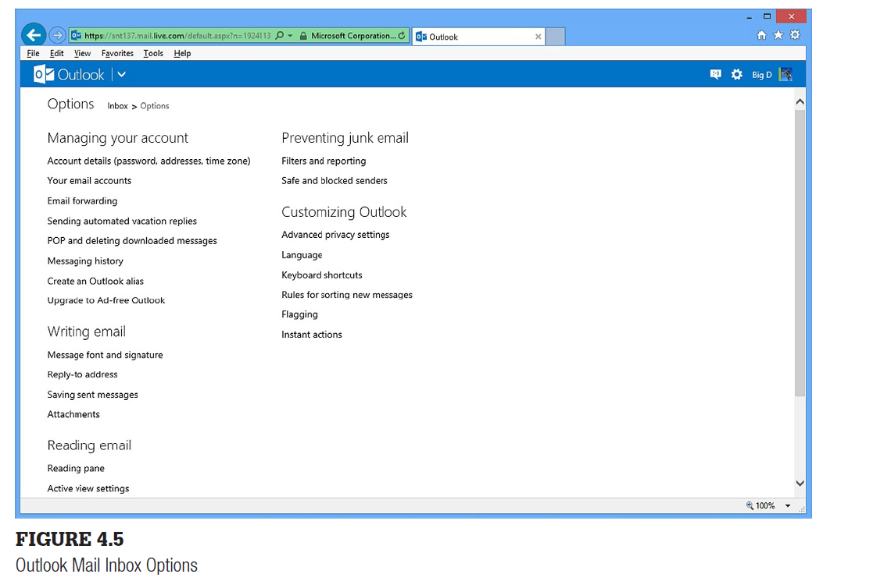

Slide 11
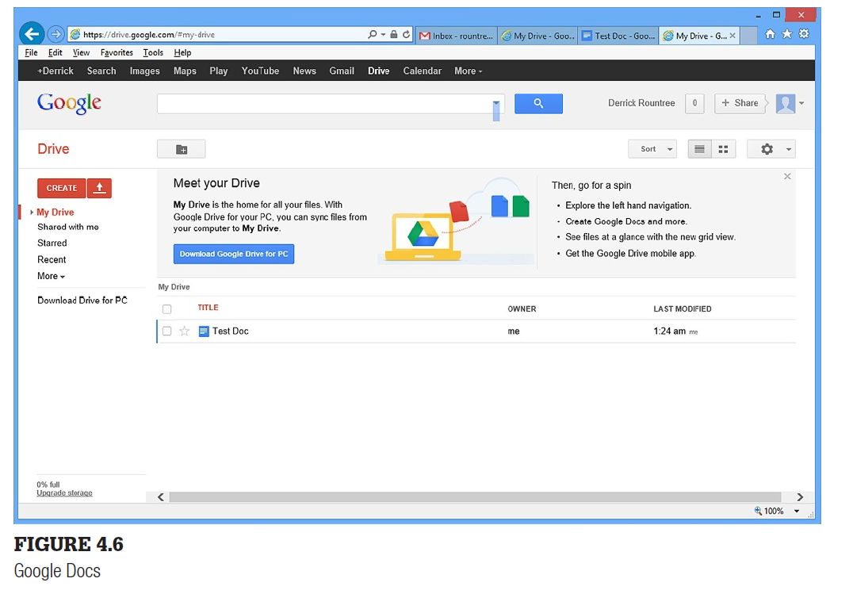
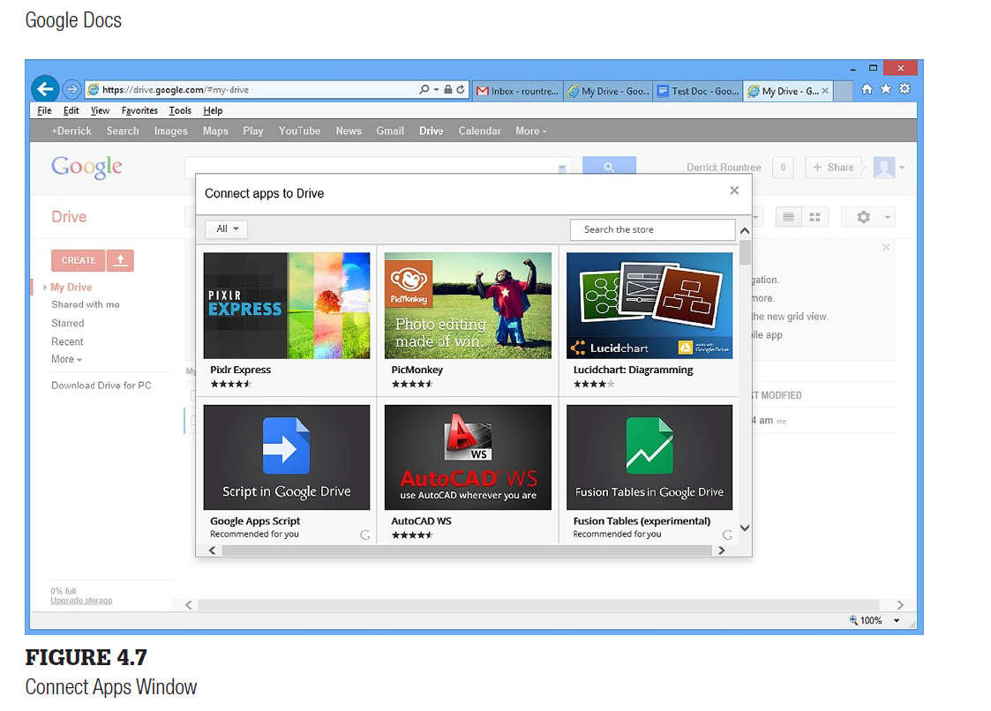

Slide 12
Google Drive, shown in Figure 4.6, gives you online access to view and create word processing documents, spreadsheets, presentations, and a host of other documents.
You can use the built-in document types or add new types. To add a new type of document, choose Create in the left pane and select Connect More Apps. This will bring up the Connect Apps window shown in Figure 4.7.
Salesforce.com 1 is a well-known customer relationship management (CRM) application used for financial, delivery, and staffing related to business systems operations. A CRM application consists of a set of workflows (business processes) together with software that helps manage customer related activities and information.

Slide 13
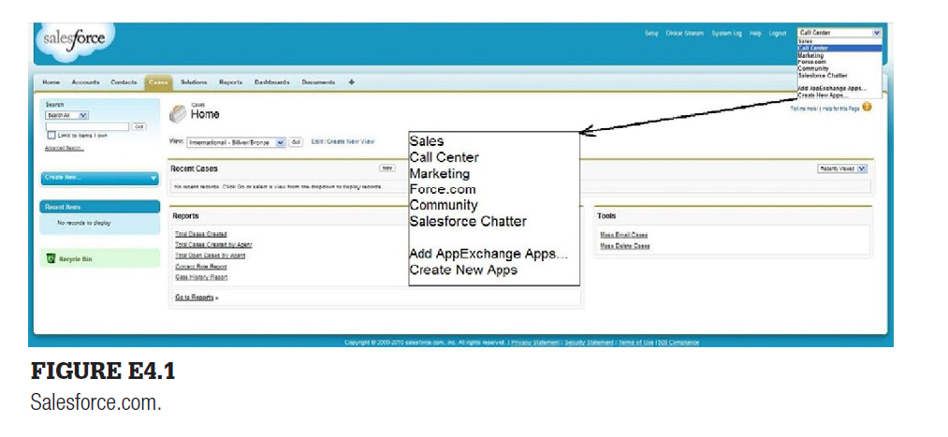

Slide 14
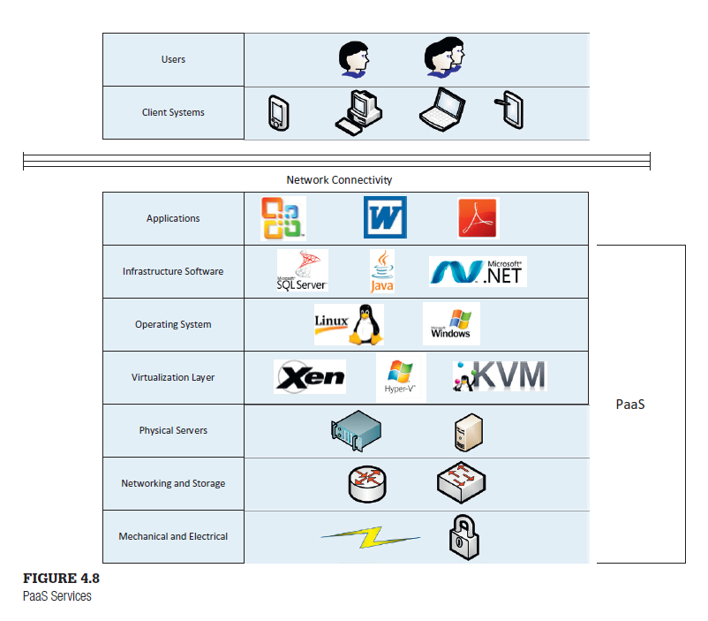
Paas

Slide 15
PaaS Characteristics
Customization: With PaaS, you have complete control over the application, so you are free to customize the application as you see fit. There will likely be different configuration options that you can set, but true customization will be limited.
Analytics: Since you, The customer, will be creating the applications, you will have the ability to view application usage and determine trends. You will be able to see which components are getting the most use and which ones are not being used.
Integration: In a PaaS environment, the data will be stored at the provider site, but the customer will have direct access to it. Conducting business intelligence and reporting should not be a problem from an access point of view, but you could run into issues when it comes to bandwidth usage, because you may be moving large amounts of data between your internal environment and the provider’s environment. So there might be performance concerns there, as opposed to access or functionality concerns.

Slide 16
PaaS Characteristics
PaaS Responsibilities: Responsibilities are somewhat distributed between the service provider and the customer.
The provider will take care of everything at the development platform level and below. The provider will make sure the operating system is patched and up to date when it’s delivered to you. The provider will also do periodic operating system updates that will be rolled out to you.
In a PaaS implementation, the customer is generally responsible for installing and maintaining any additional applications you will need. The database platform may be supplied to customer, but customer will be responsible for the data and will be able to implement an direct data fix that might need to perform.

Slide 17
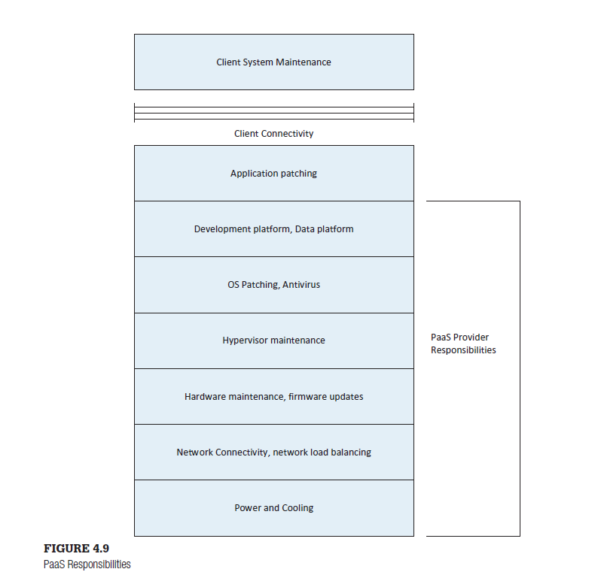

Slide 18
PaaS Challenges
Flexibility Challenges: You may have difficulty finding a provider with the platform you need. If you need a special set or special configuration, you might not be able to find a provider that offers what you need.
Security Challenges: The provider will have administrative control over the operating system and the database platform. Since the provider has direct access to the systems, they will have direct access to all of the applications and data.

Slide 19
PaaS Providers
Windows Azure
Google App Engine

Slide 20
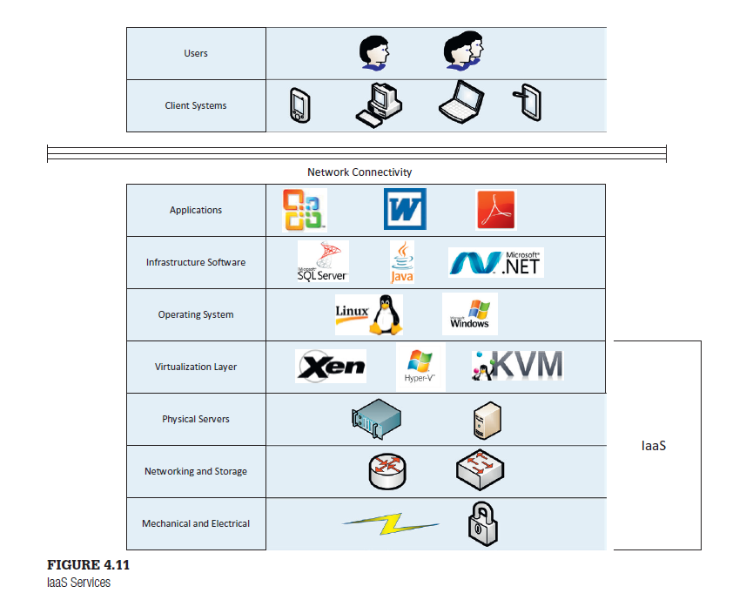
IaaS
IaaS provides core services such as computing power, storage, networking, and operating systems. You can then build your environment on top of these resources

Slide 21
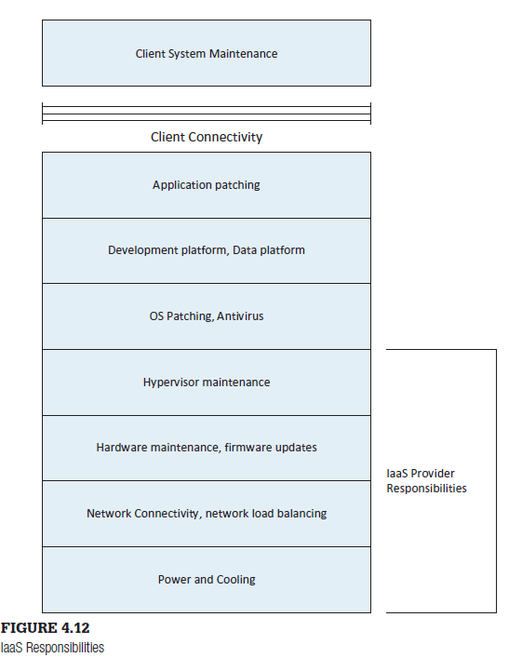
IaaS Characteristics
Responsibilities: the customer is responsible for most of the environment. The physical hardware will be stored in the provider’s datacenter, but the customer may have full access to it. The customer is responsible for obvious things like operating system and application maintenance.

Slide 22
IaaS Challenges
In many IaaS environments, you are charged for resource usage, such as processor and memory. Unless you carefully monitor your system usage, you may be in for a shock when the bill comes.
Security: The provider does not need access to the actual operation system or items at a higher level, there is no need for them to have administrative accounts on the system. This can give the customer at least some level of comfort regarding security.

Slide 23
IaaS Providers
Amazon EC2
Rackspace

Slide 24
ADDITIONAL SERVICE MODELS
Database as a Service:
DbaaS provides a database platform organizations can use to store their data.
Many PaaS providers also provide database services.
Desktop as a Service
DaaS provides users with a virtual desktop that can be used to perform desktop computing.

Slide 25
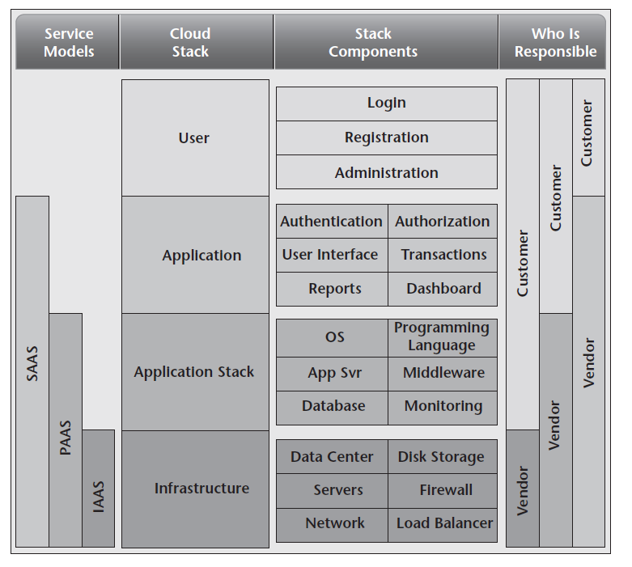
Cloud Stack

Slide 26
Learning Activity 1:
Pick your favourite business SaaS application and write a post of 100 words discussing what features and characteristics of the application you like the best. What do you think business would be like for the application’s developers had they stuck with a traditional IT model?

Slide 27
Learning Activity 2:
One of the challenges of taking up cloud-based services for any organisation (or even individuals!) is the human tendency to stick with the familiar and resistance to change. This is evident across many groups, based on many factors including age, background, experience and so on.
In this thinking exercise, you are asked to reflect on what you have seen so far in Modules 1 to 4. List what aspects of adopting the various cloud services and deployment models you may anticipate hesitation and challenges in. Feel free to tell stories of your past experiences in your post. You can also do some research and explain where you think the challenges may stand. One great resource where you will find challenges specific to the APAC region is in the Additional Learning Resources section.

Slide 28


